Slide 1
Chapter 9 Morphological Image Processing

Slide 2
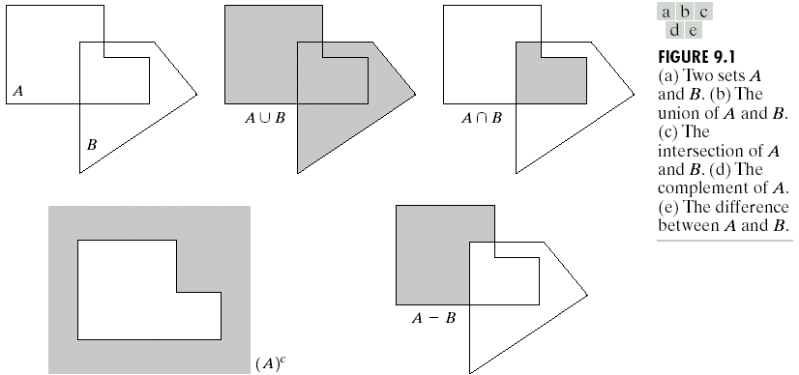
Some Basic Concepts from set theory

Slide 3
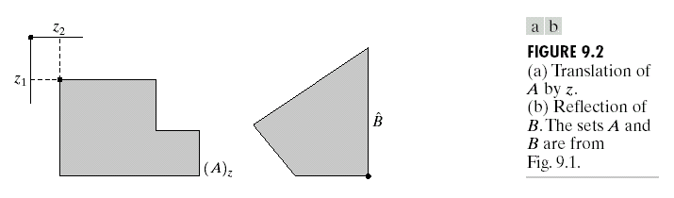
Some Basic Concepts from set theory
Translation
Reflection

Slide 4
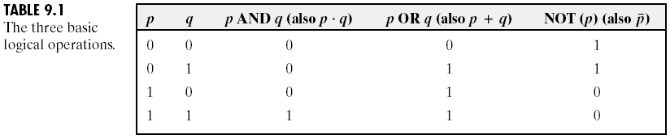
Logic operations involving Binary Images

Slide 5
Logic operations involving Binary Images
A
B

Slide 6
Dilation
With A and B as sets in Z², the dilation of A by B is defined as
where : the reflection of B about its origin and shifting this reflection by z
The dilation of A by B is the set of all displacements, z, such that and A overlap by at least one element. Thus,
Set B is referred to as the structuring element in dilation.

Slide 7
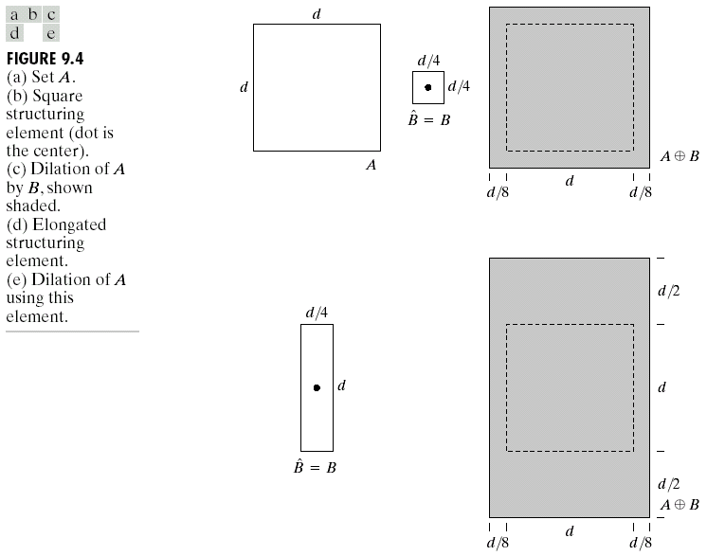
Dilation

Slide 8
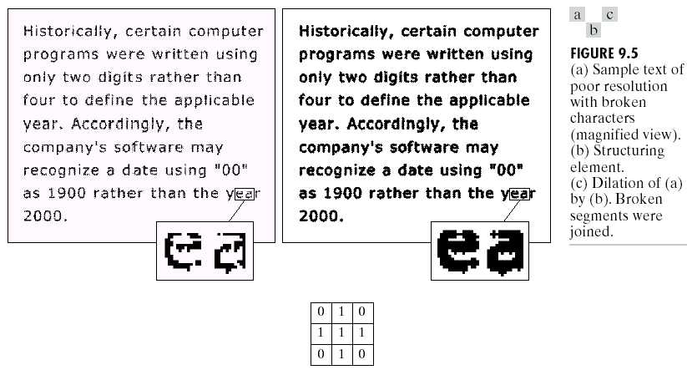
Dilation Example
Structuring element

Slide 9
Erosion
For sets A and B in Z², the erosion of A by B is defined as
where : the reflection of B about its origin and shifting this reflection by z
The erosion of A by B is the set of all points z, such that B, translated by z is contained in A.

Slide 10
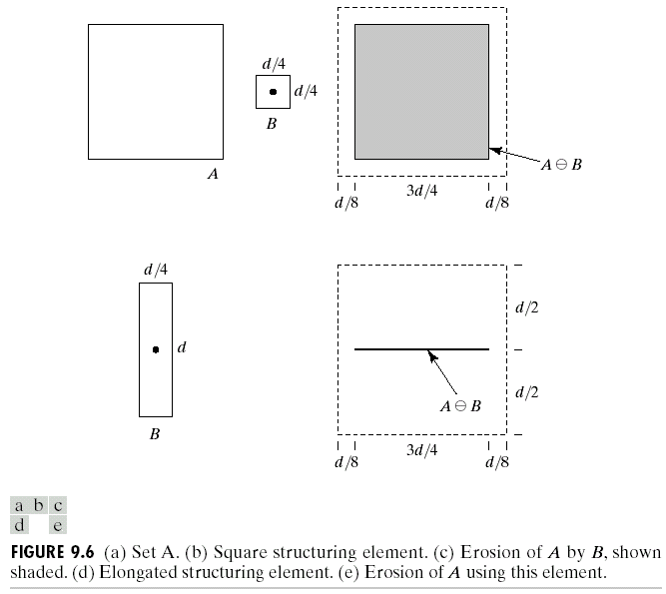
Erosion

Slide 11
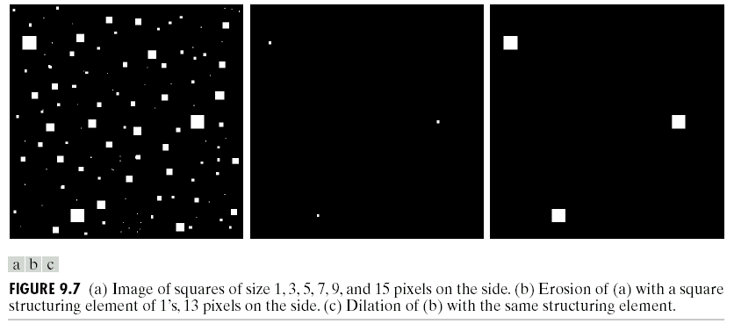
Dilation and Erosion
Erosion Example

Slide 12
Opening and Closing
Opening:
smooth the contour of an object, break narrow isthmuses, and eliminate thin protrusions.
The opening A by B is the erosion of A by B, followed by a dilation of the result by B
Closing:
smooth sections of contours but it generally fuses narrow breaks and long thing gulfs, eliminates small holes, and fills gaps in the contour.

Slide 13
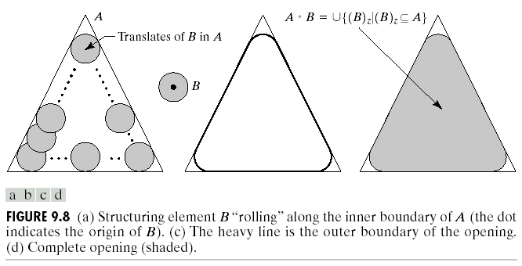
Opening and Closing
Opening

Slide 14
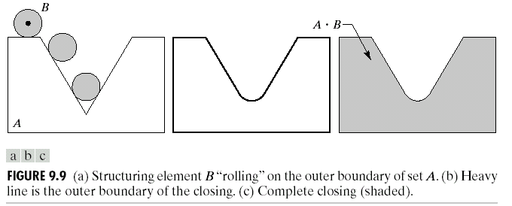
Opening and Closing
Closing

Slide 15
Opening and Closing
Opening Example

Slide 16
Opening and Closing
Closing Example

Slide 17
Opening and Closing
The opening operation satisfies the following properties:
is a subset (subimage) of A.
If C is a subset of D, then is a subset of .
The closing operation satisfies the following properties:
A is a subset (subimage) of .
If C is a subset of D, then is a subset of .

Slide 18
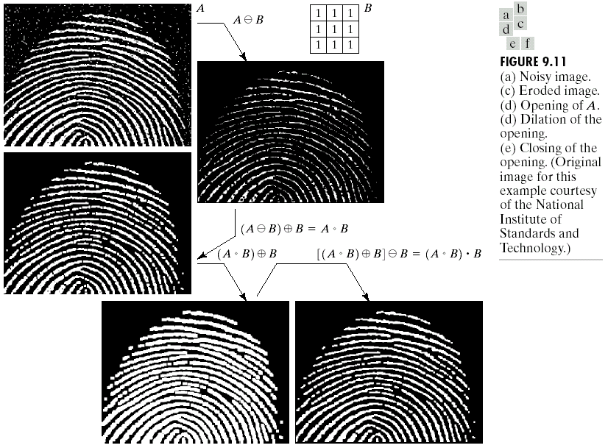
Opening and Closing

Slide 19
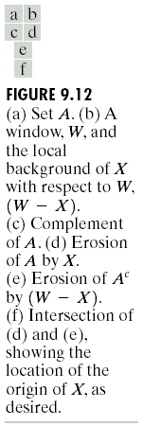
The Hit-or-Miss Transformation
＊

Slide 20
The Hit-or-Miss Transformation
＊

Slide 21
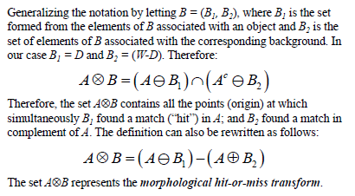
Hit and Miss Transform

Slide 22
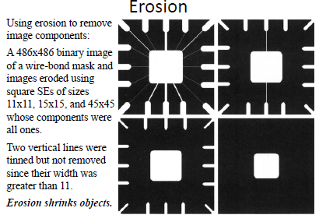

Slide 23
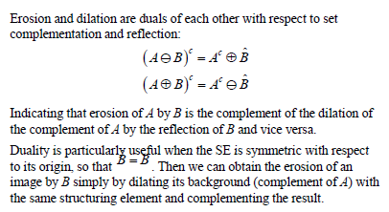
Duality

Slide 24
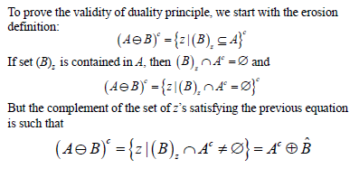
Duality Proof

Slide 25
Examples
M

Slide 26
Erosion
Dilation
L
L
L/2
L
L/2
L

Slide 27
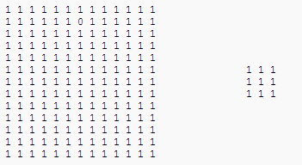
Exercises

Slide 28
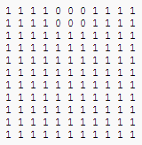
Erosion Result

Slide 29
Morphological Algorithms
Boundary Extraction
Region Filling
Connected Components Extraction
Convex Hull
Thinning
Pruning
Skeleton
Thickening

Slide 30
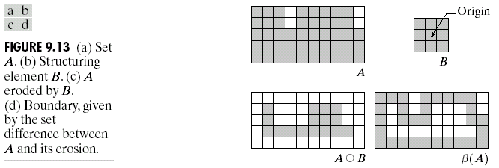
Some Basic Morphological Algorithms
Boundary Extraction
The boundary of a set A,
where B is a suitable structuring element.

Slide 31
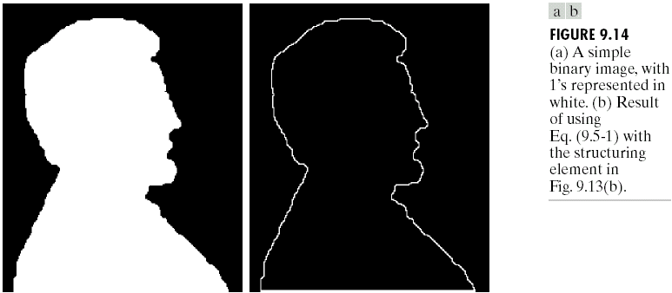
Some Basic Morphological Algorithms
Boundary Extraction Example

Slide 32
Some Basic Morphological Algorithms
Region Filling
The following procedure can fill the region:
where X₀ = p, and B is the symmetric structuring element shown in Fig. 9.15.
Note that p is the initial point we should assign.

Slide 33
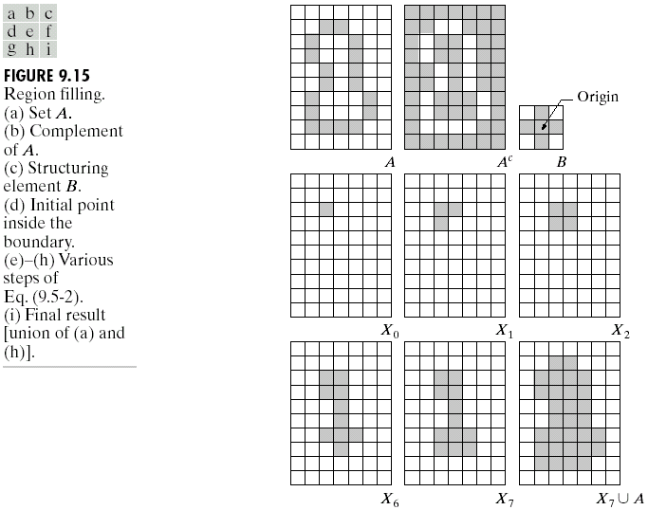
Some Basic Morphological Algorithms
Region Filling
0
1
X₀=p

Slide 34
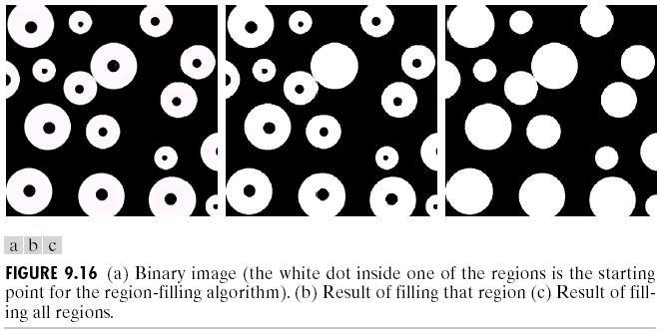
Some Basic Morphological Algorithms
Region Filling

Slide 35
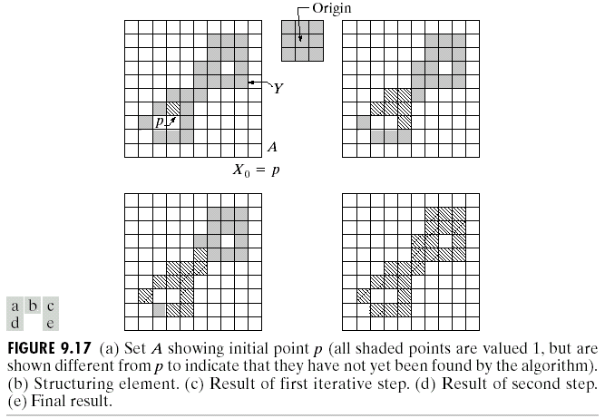
Some Basic Morphological Algorithms
Extraction of Connected Components

Slide 36
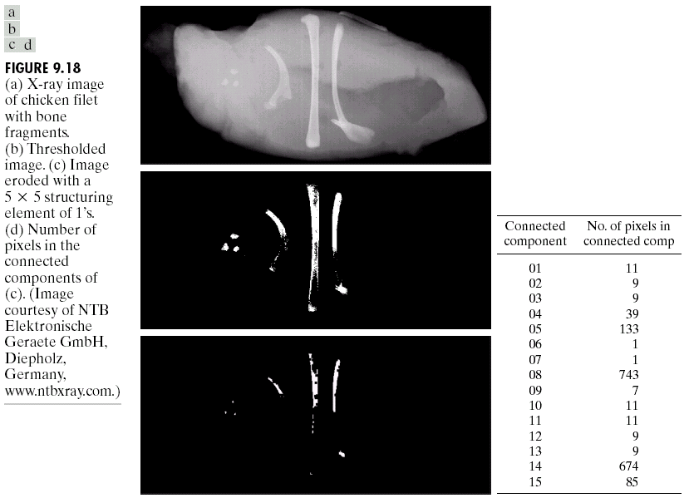
Some Basic Morphological Algorithms
Extraction of Connected Components

Slide 37
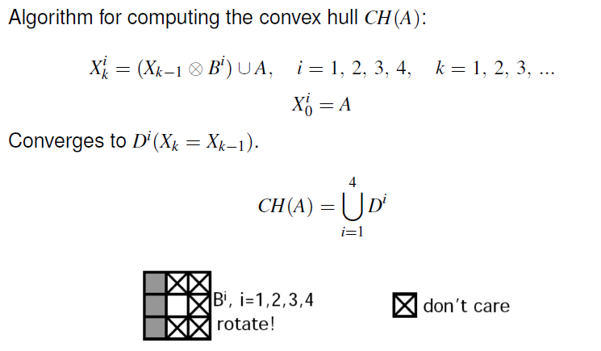
Convex hull

Slide 38
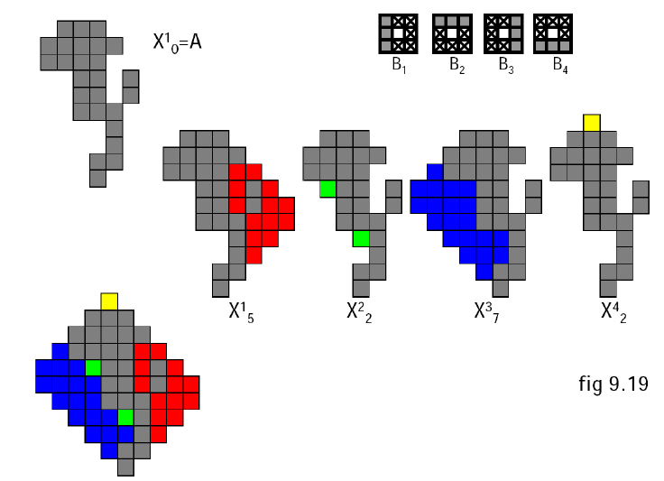

Slide 39
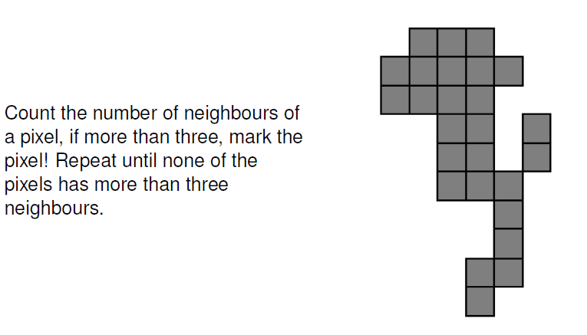

Slide 40
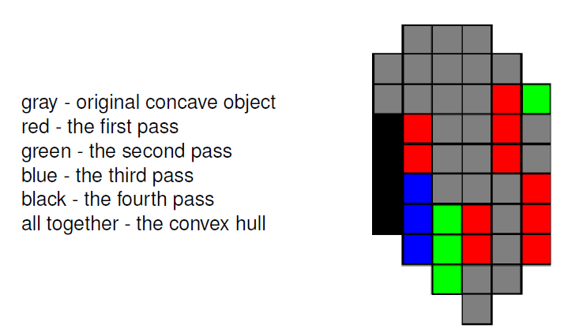

Slide 41
Some Basic Morphological Algorithms
Thinning
The thinning of a set A by a structuring element B can be defined in terms of the hit-or-miss transform:
A more useful expression for thinning A symmetrically is based on a sequence of structuring elements:
＊
＊

Slide 42
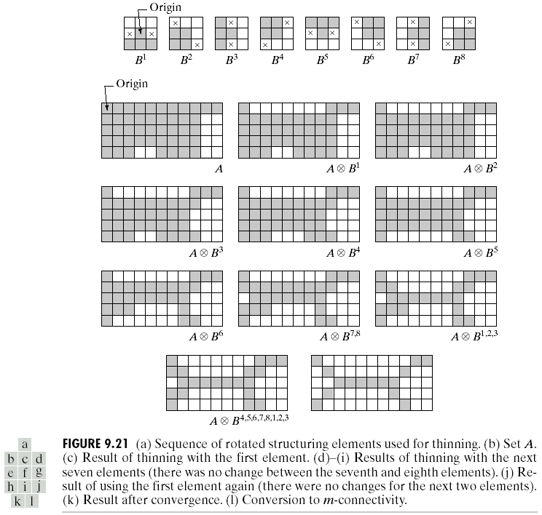
Some Basic Morphological Algorithms
Thinning

Slide 43
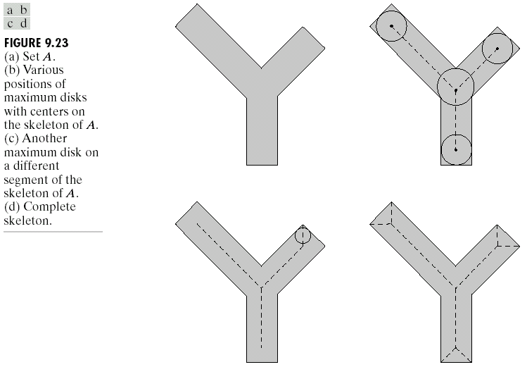
Some Basic Morphological Algorithms
Skeletons

Slide 44
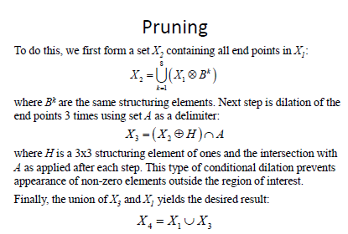

Slide 45
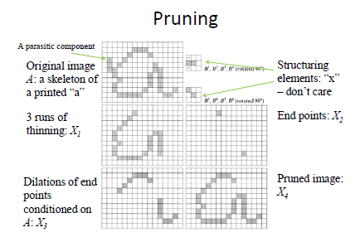

Slide 46
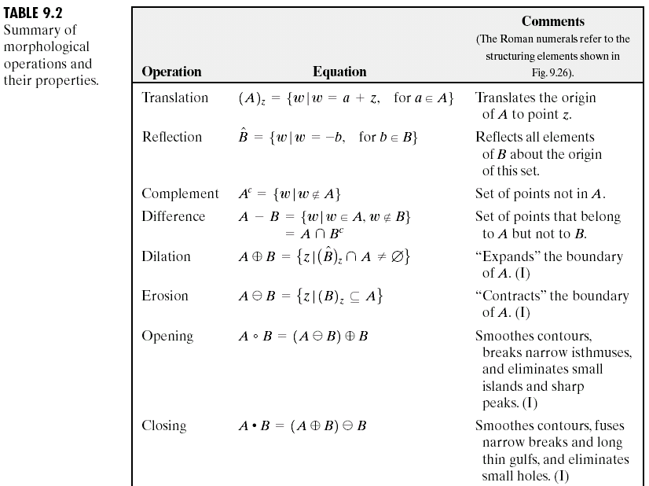
Summary of Morphological Operations
and Their Properties

Slide 47
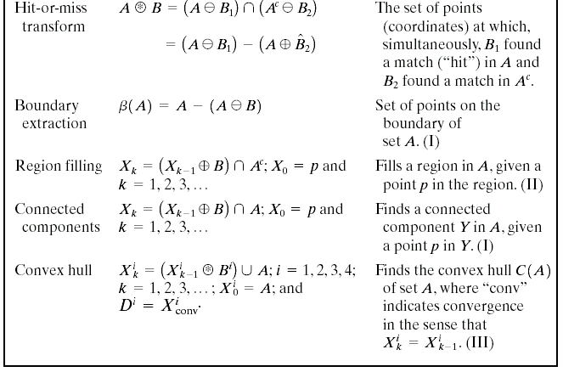
Summary of Morphological Operations
and Their Properties

Slide 48
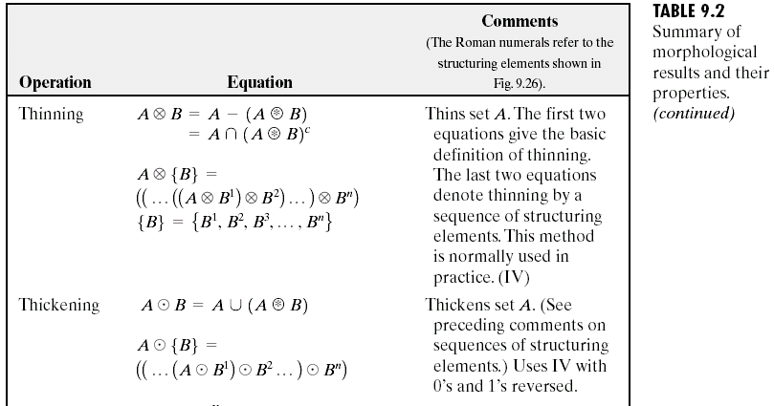
Summary of Morphological Operations
and Their Properties

Slide 49
Summary of Morphological Operations
and Their Properties

Slide 50
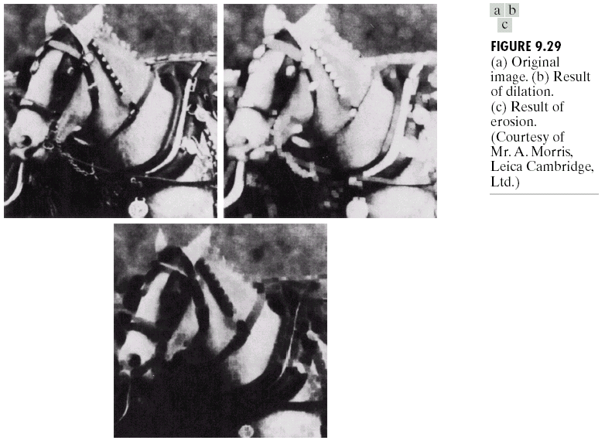
Extensions to Gray-Scale Images

Slide 51
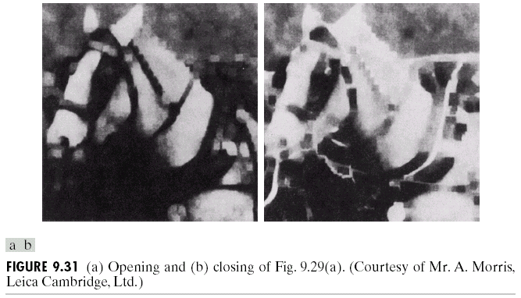
Extensions to Gray-Scale Images

Slide 52
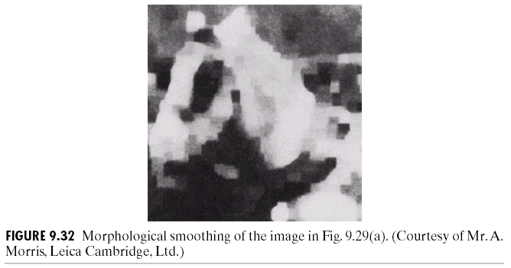
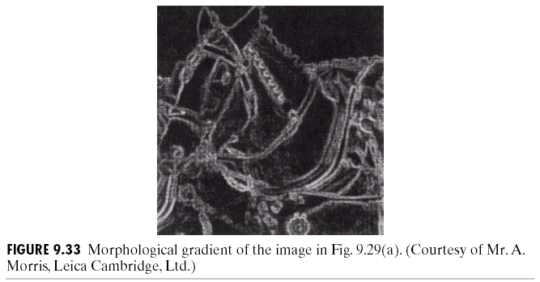
Extensions to Gray-Scale Images

